Slide 1
https://twiki.cern.ch/twiki/pub/CMSPublic/SummaryResultsHIG/run2_plot_BRaa_Type2_tanbeta2.png

Slide 2
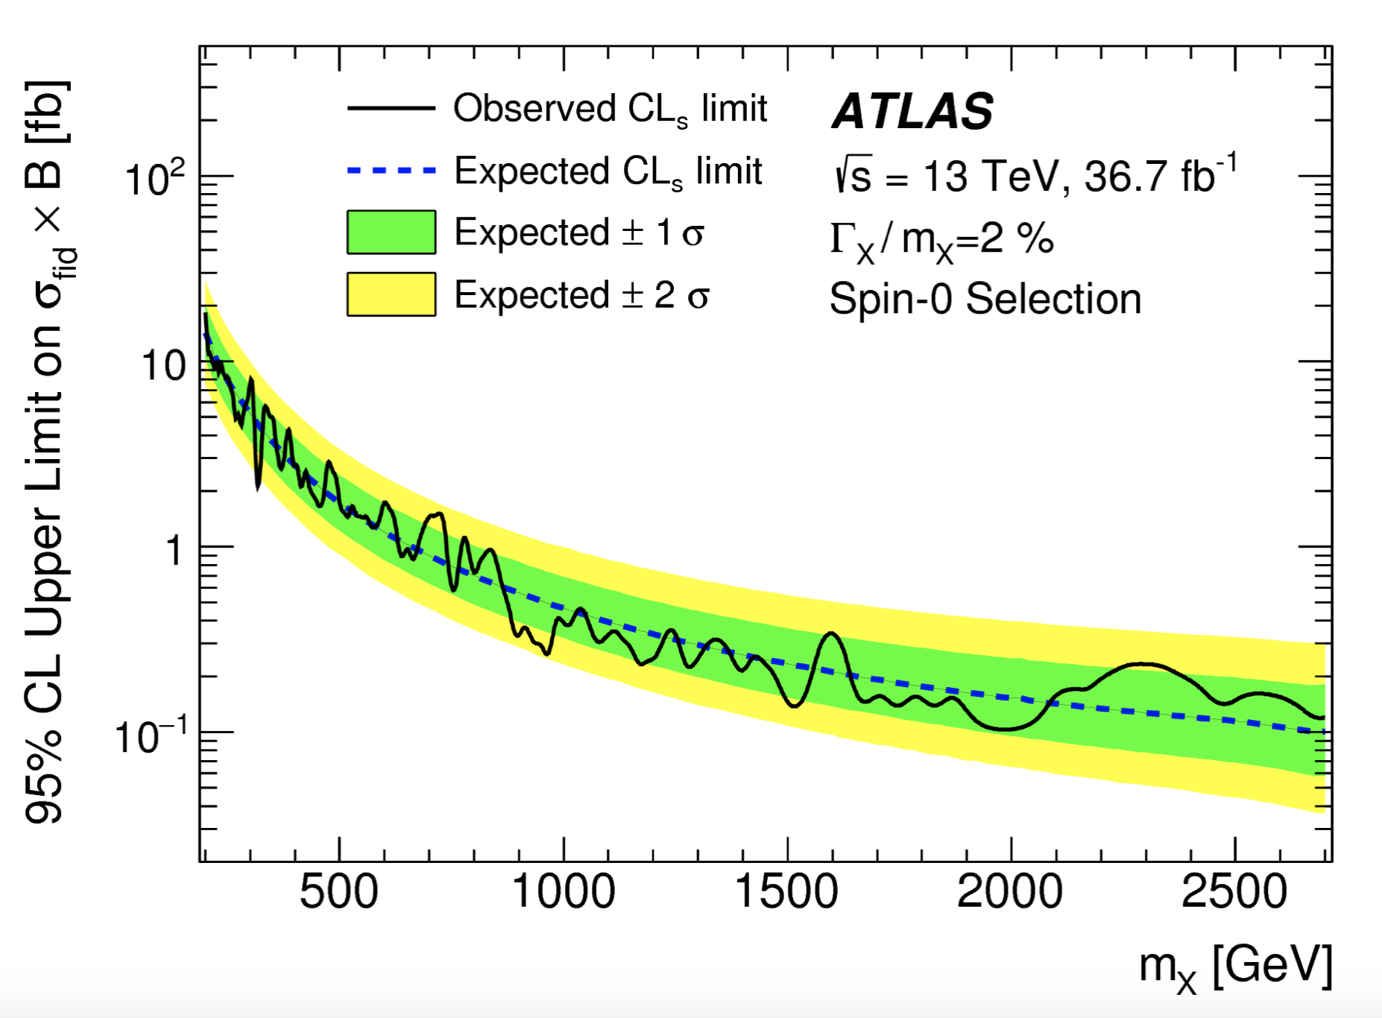
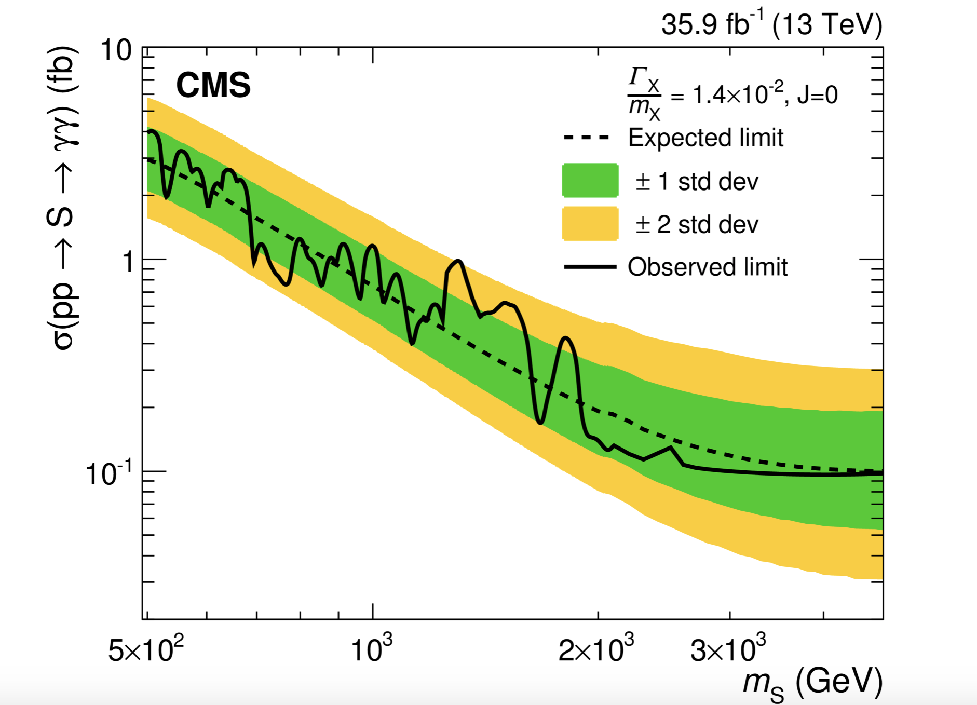

Slide 3
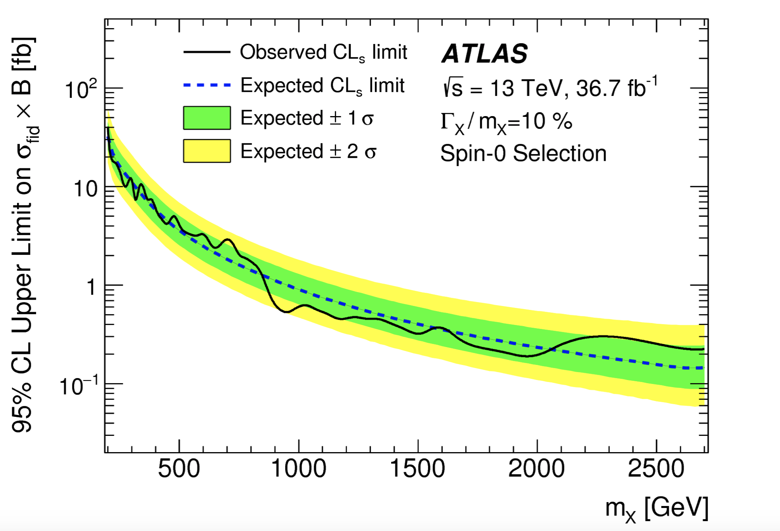
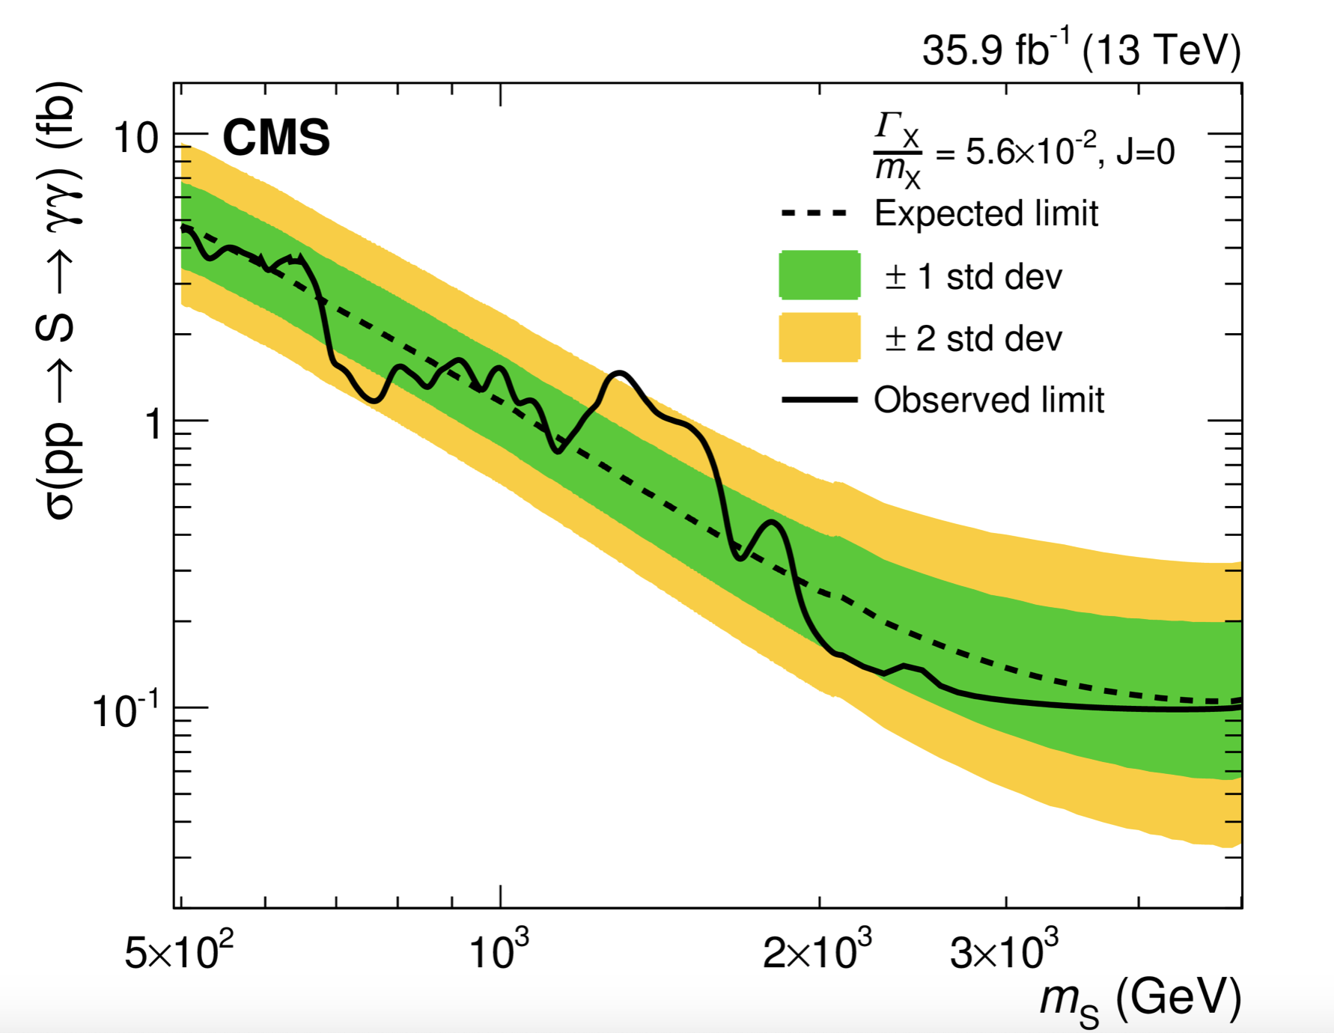

Slide 4
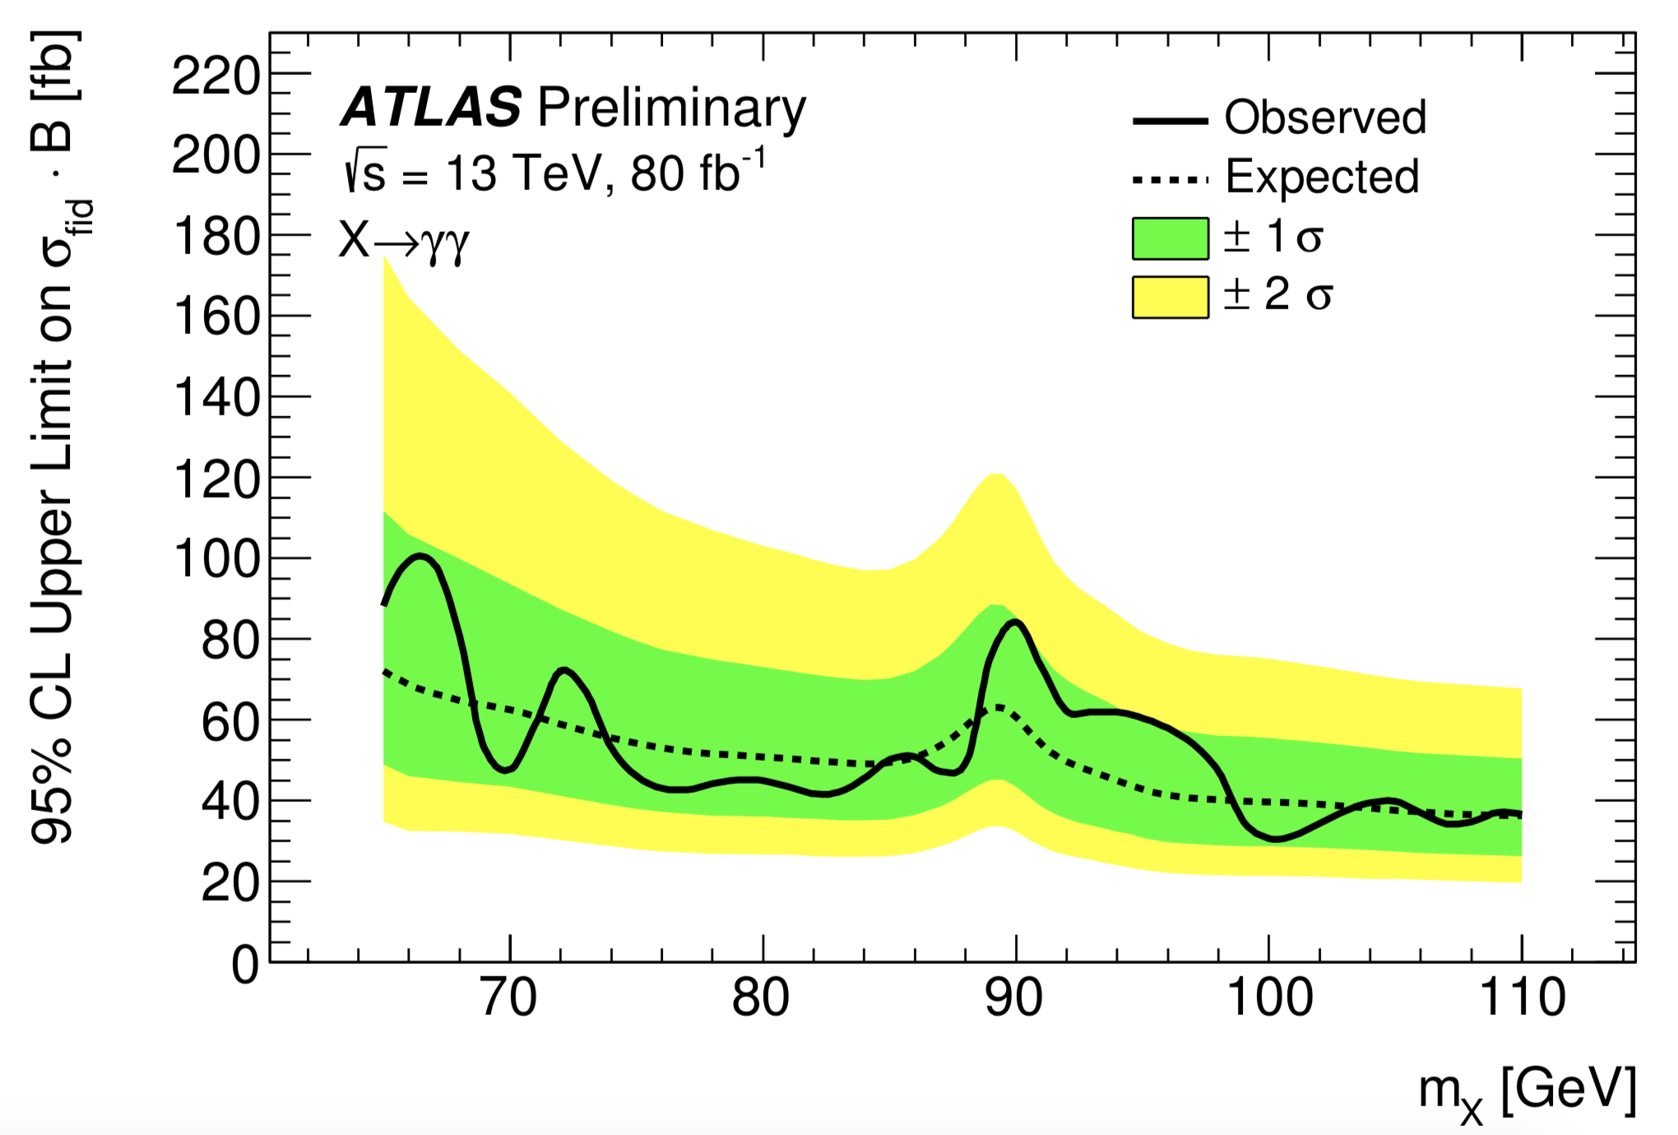

Slide 5
Notes:
Tt https://arxiv.org/pdf/1704.07323.pdf
http://arxiv.org/abs/1908.01115

Slide 6
AZh

Slide 7
h aa
https://arxiv.org/abs/1802.03388. ATLAS 4l 1-60 GeV 36
@https://arxiv.org/abs/1805.04865 CMS 15-65 mumutautau 36[/SM]
@https://arxiv.org/abs/1907.07235。CMS 4-15 4tau[/SM]
@https://arxiv.org/abs/1812.06359 CMS 20-62.5 mumubb
@https://arxiv.org/abs/1807.00539. ATLAS 2—60 mumubb [/SM]
@https://arxiv.org/abs/1805.10191. CMS 15-60 tautau bb[/SM]
@https://arxiv.org/abs/1806.07355. ATLAS 20-60 4b

Slide 8
https://arxiv.org/abs/1812.00380. CMS mumu 0.25 - 8.5 GeV

Slide 9
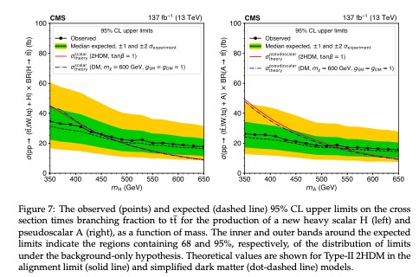
Tt 1908.06463.pdf
width 5%

Slide 10
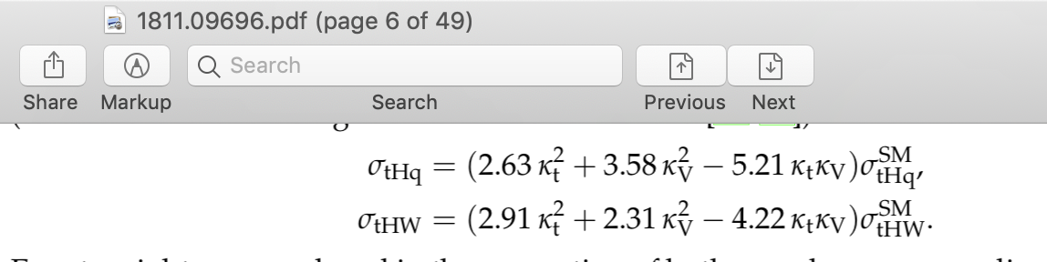
1704.07323.pdf out of date

Slide 11
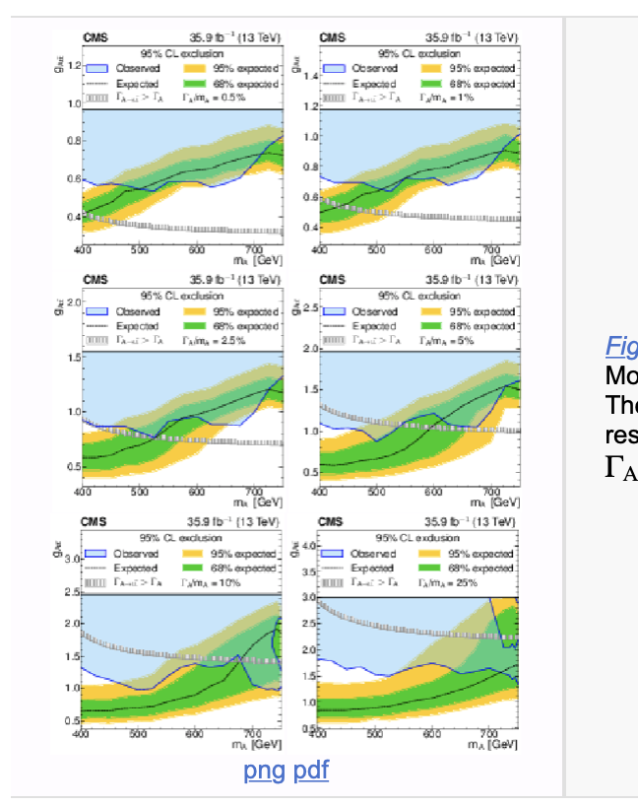
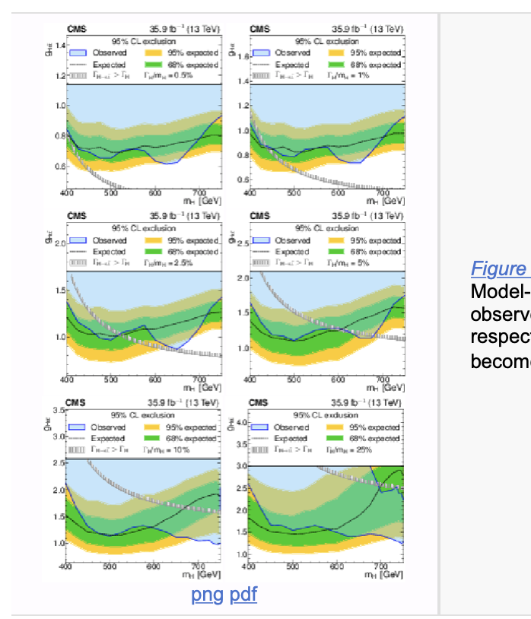
arXiv:1908.01115

Slide 12
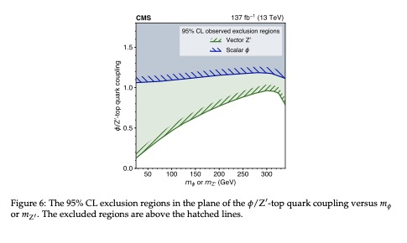
4t 1908.06463.pdf

Slide 13
4t. 1807.11883.pdf

